Slide 1
Equations of State with a Chiral Critical Point
Joe Kapusta
University of Minnesota
Collaborators: Berndt Muller & Misha Stephanov;
Juan M. Torres-Rincon; Clint Young, Michael Albright

Slide 2
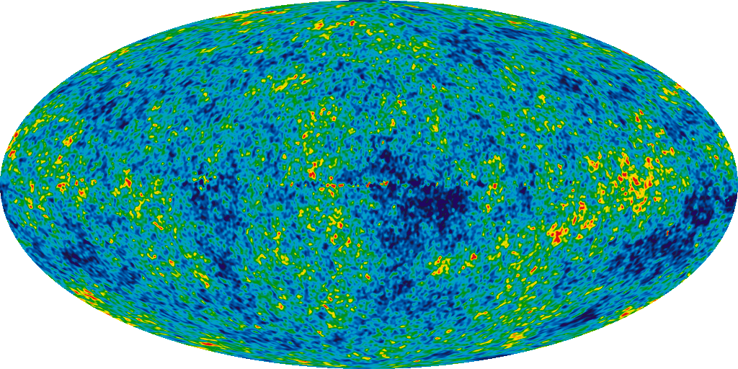
Fluctuations in temperature of cosmic
microwave background radiation
WMAP picture
WMAP 7 years

Slide 3
Sources of Fluctuations in High Energy Nuclear Collisions
Initial state fluctuations
Hydrodynamic fluctuations due to finite particle number
Energy and momentum deposition by jets traversing the medium
Freeze-out fluctuations

Slide 4
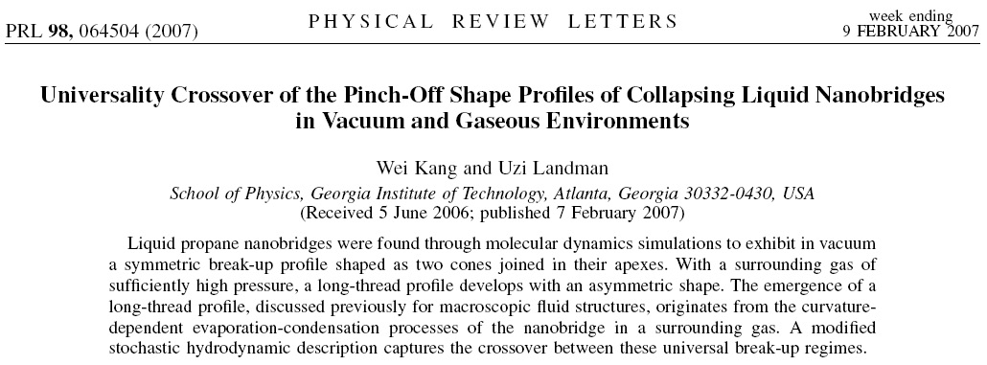
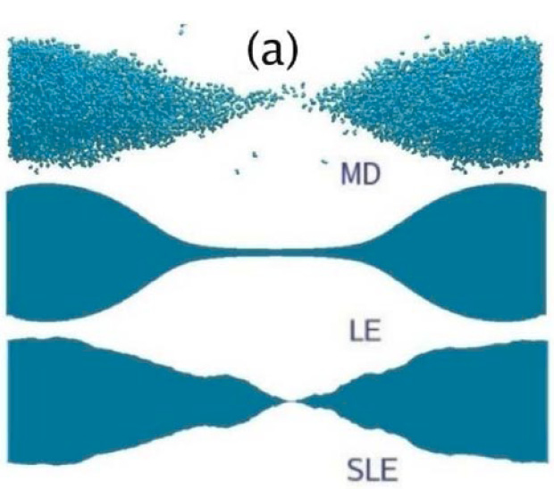
Molecular Dynamics
Lubrication Equation
Stochastic Lubrication
Equation

Slide 5
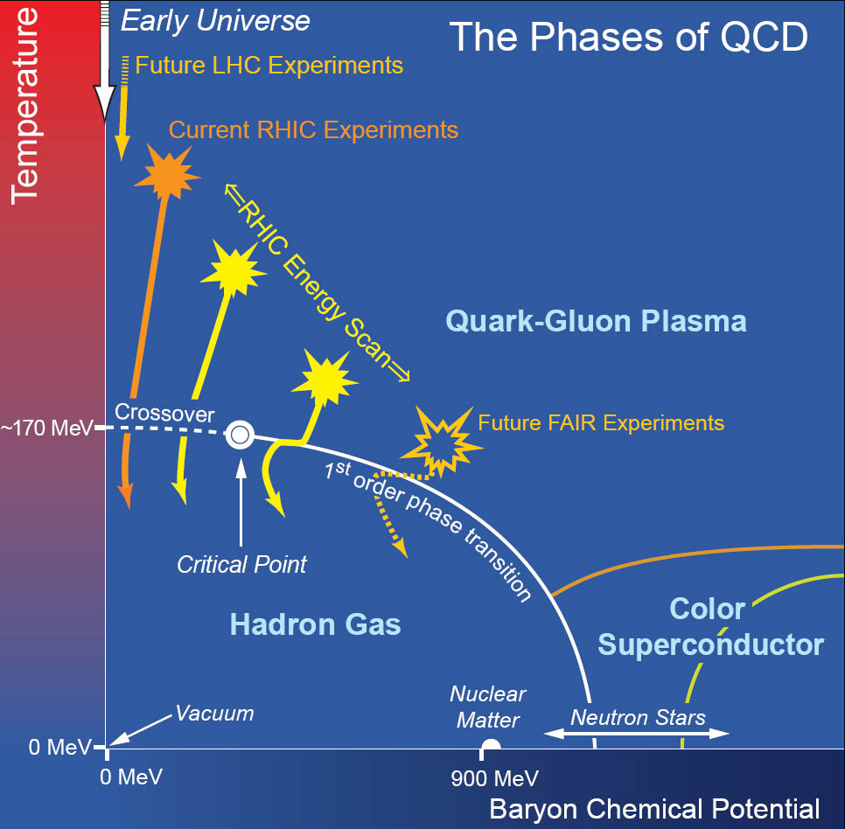
Fluctuations Near the Critical Point
NSAC 2007 Long-range Plan

Slide 6
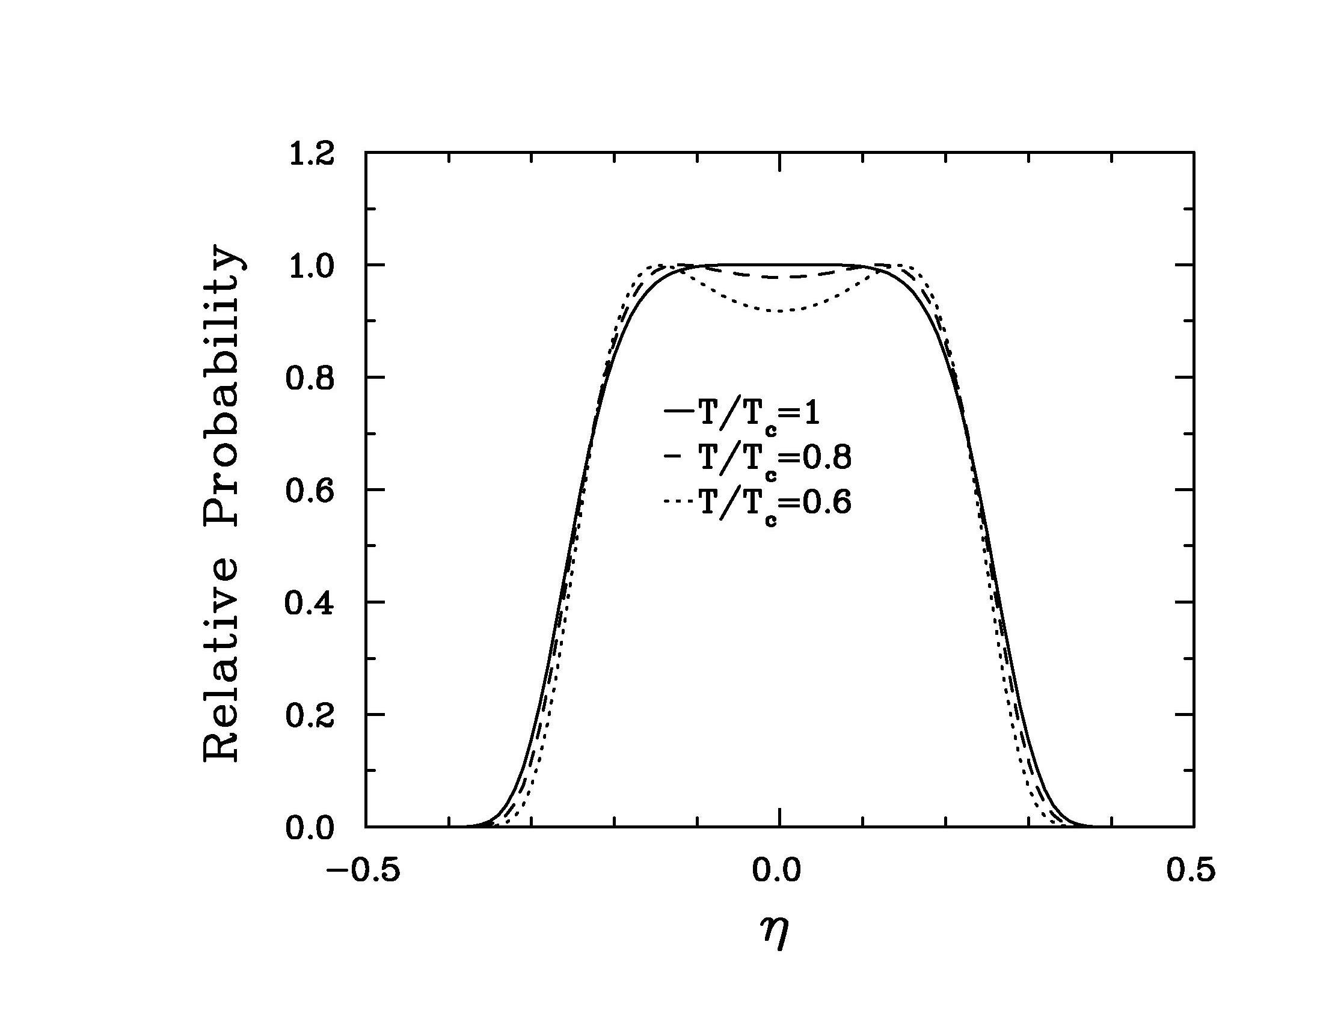
Volume = 400 fm³
=(n-n_{c})/n_{c}
Incorporates correct critical exponents and amplitudes - Kapusta (2010)
Static univerality class: 3D Ising model & liquid-gas transition

Slide 7
But this is for a small system
in contact with a heat and
particle reservoir.
Must treat fluctuations in an
expanding and cooling system.

Slide 8
Extend Landau’s theory of hydrodynamic
fluctuations to the relativistic regime
Stochastic sources

Slide 9
Procedure
Solve equations of motion for arbitrary source function
Perform averaging to obtain correlations/fluctuations
Stochastic fluctuations need not be perturbative
Need a background equation of state

Slide 10
Mode coupling theory – diffusive heat and viscous
are slow modes, sound waves are fast modes
Fixman (1962) Kawasaki (1970,1976) Kadanoff & Swift (1968) Zwanzig (1972)
Luettmer-Strathmann, Sengers & Olchowy (1995) together with Kapusta (2010)
= specific heat x Stokes-Einstein diffusion law x crossover function
Dynamic universality class: Model H of Hohenberg and Halperin

Slide 11
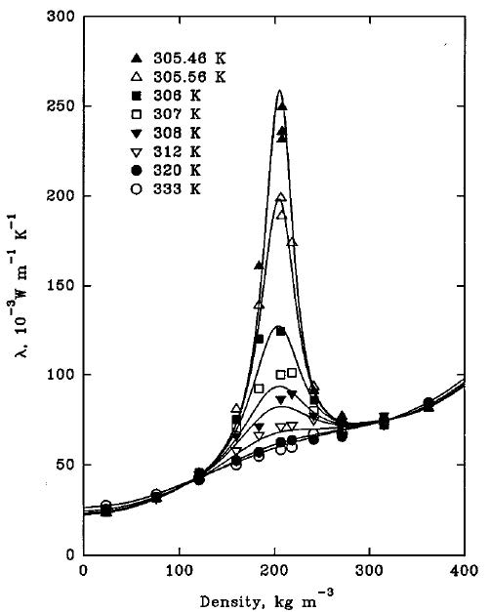
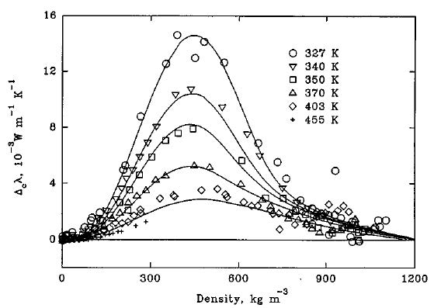
Luettmer-Strathmann, Sengers & Olchowy (1995)
carbon dioxide
ethane
Data from various experimental groups.

Slide 12
Excess thermal conductivity

Slide 13
Will hydrodynamic fluctuations
have an impact on our ability
to discern a critical point in the
phase diagram (if one exists)?

Slide 14
Simple Example: Boost Invariant Model
Linearize equations of motion in fluctuations
noise
Solution:
response function
enhanced near critical point

Slide 15
quarks & gluons
critical point
baryons & mesons

Slide 16
Excess thermal conductivity on the flyby

Slide 17
Fluctuations in the local temperature,
chemical potential, and flow velocity fields
give rise to a nontrivial 2-particle
correlation function when the fluid
elements freeze-out to free-streaming
hadrons.

Slide 18
Magnitude of proton correlation function depends strongly
on how closely the trajectory passes by the critical point.

Slide 19
One central collision
Pb+Pb @ LHC
Zero net baryon density
Noisy 2nd order viscous hydro
Transverse plain
Clint Young – U of M

Slide 20
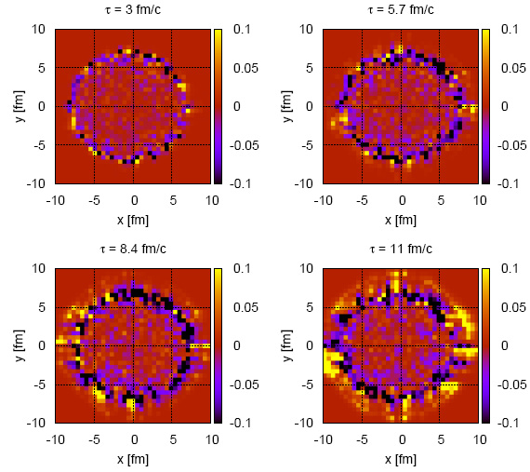

Slide 21
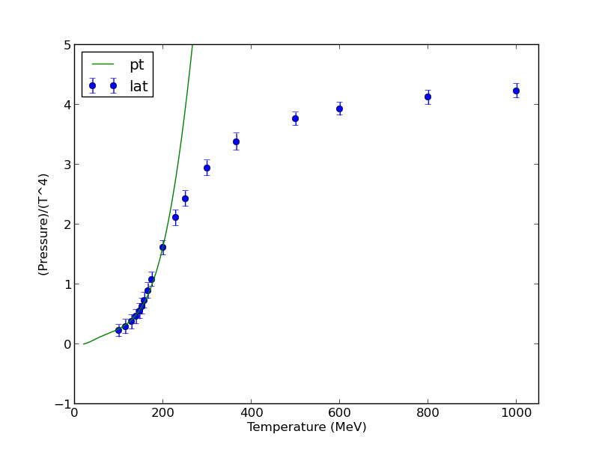
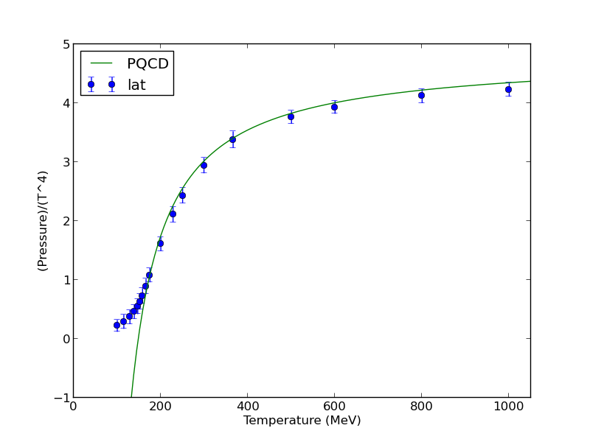
Matching looks straighforward…
All hadrons in PDG listing
treated as point particles.
Order g⁵ with 2 fit paramters

Slide 22
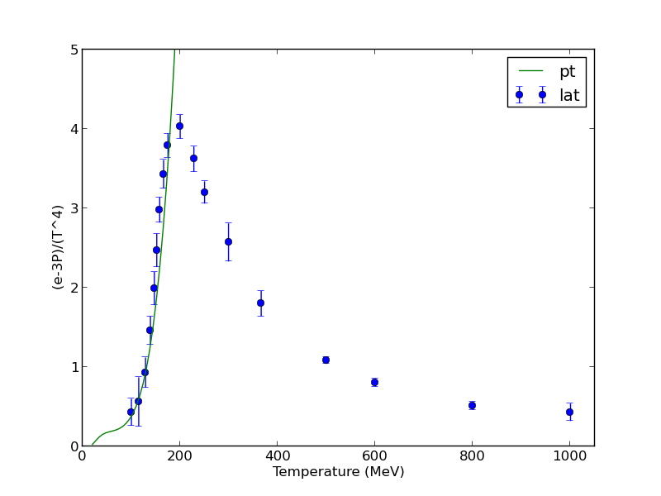
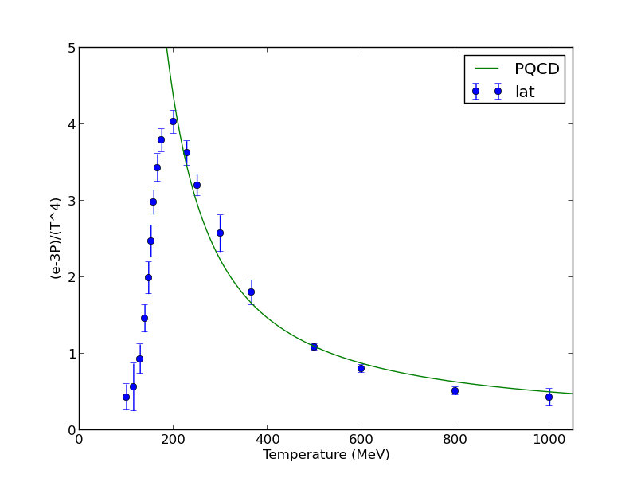
…but it is not.
All hadrons in PDG listing
treated as point particles.
Order g⁵ with 2 fit paramters

Slide 23
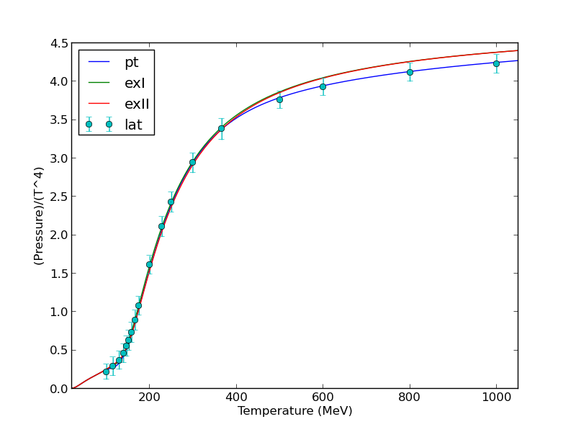
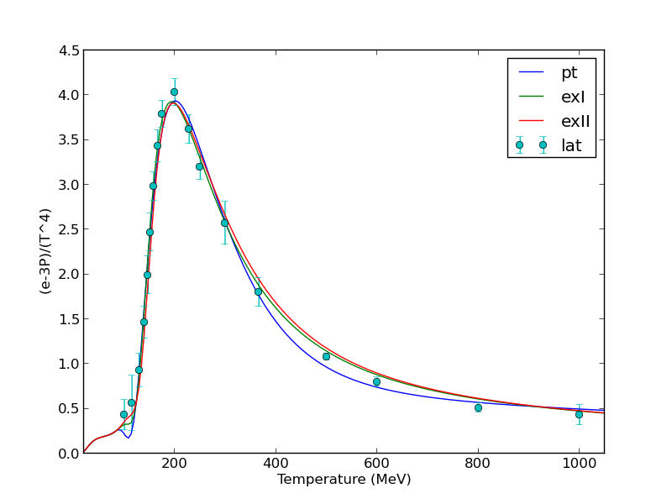

Slide 24
Doing the matching at finite temperature
and density, while including a critical
point with the correct critical exponents
and amplitudes, is challenging!
Typically one finds bumps, dips, and
wiggles in the equation of state.

Slide 25
Summary
Fluctuations are interesting and provide
essential information on the critical point.
Fluctuations are enhanced on a flyby of the
critical point.
There is clearly plenty of work for both theorists and experimentalists!
Supported by the Office Science, U.S. Department of Energy.

